Slide 1
Department of Computer Science and Engineering
JP Nagar, Kothanur, Bengaluru - 560076
REAL TIME DETECTION , SEGMENTATION AND ENHANCEMENT OF EYE IMAGES FOR IMPROVED VISUAL ANALYSIS
Academic year 2024 – 2025 Odd (5th) semester
Presented by:
Neha Dinesh Rangdal- 1RF22CS074
Ayush Patravali - 1RF22CS023
Sujith Chand – 1RF22CS113
Pooja M Honna - 1RF22CS079
Pravardhan Prasad – 1RF22CS082

Slide 2
Contents
Introduction
i. Background
ii. Objective
Literature Survey
Methodology
Expected outcome of the mini project
References

Slide 3
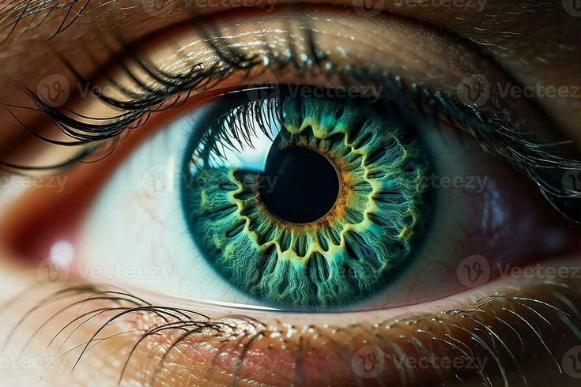
INTRODUCTION
BACKGROUND
Enhance accuracy in applications such as medical diagnostics, biometrics, and facial recognition
Develop a real-time system using YOLOv5 for precise detection of eye structures like the pupil, iris, and sclera.

Slide 4
INTRODUCTION
OBJECTIVE
To develop a real-time system that accurately detects facial structures and specifically isolates the eyes within face images using YOLOv5.
To provide enhanced visual clarity of the detected eyes through segmentation and image enhancement techniques.

Slide 5
METHODOLOGY
The methodology for this mini-project involves the following steps:
1. Data Collection and Preprocessing
2. Model Training
3. Image Enhancement
4. Real-time Implementation
5. Evaluation

Slide 6
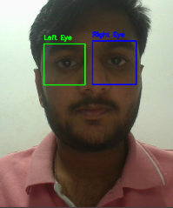
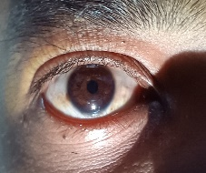
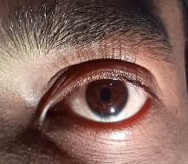
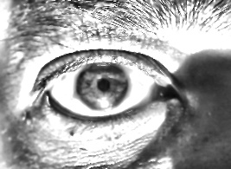
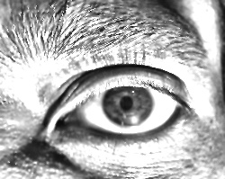
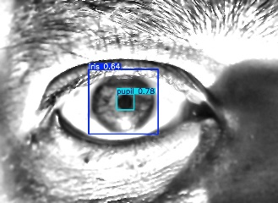
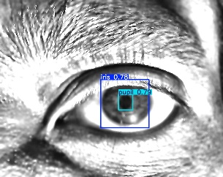
Suggested Approach
1. Capture
2. Extract eye
3. Image enhancement
Left eye
Right eye
4. Processed image
Ratios:-
3.76
3.84

Slide 7
Person | Left Eye | Right Eye
1. | 2.84 | 2.78
2. | 2.40 | 2.36
3. | 2.20 | 3.20
4. | 3.76 | 3.84
5. | 1.75 | 1.66
6. | 2.3 | 2.57

Slide 8
EXPECTED OUTCOME OF THE PROJECT
High Precision and Real-Time Performance: The project is expected to achieve high precision in detecting and segmenting the pupil and iris using YOLOv5, with real-time processing capabilities. YOLOv5's design ensures a balance between detection accuracy and speed, making it ideal for applications that require instantaneous results.
Versatile Applications: The final system will be versatile, with potential applications ranging from ophthalmological diagnostics to biometric authentication systems. By enhancing the visual analysis of eye images, the system will contribute to both medical and technological fields.

Slide 9
LITERATURE SURVEY
Year | Title | Author(s) | Description | Advantages | Drawbacks
2023 | Framework for biometric iris recognition in video, by deep learning and quality assessment of the iris‑pupil region | Eduardo Garea‑Llano, Annette Morales‑Gonzalez. | real-time iris recognition using RGB video. | Real-Time Performance, Quality Control, High Accuracy in Controlled Environments, Reduced Computational Load. | Limited to Controlled Environments, Dependency on Training Data Quality, High-Quality Camera Requirement.
2020 | YOLOv4 Object Detection Algorithm with Efficient Channel Attention Mechanism | Cui Gao, Qiang kai, Shaofeng Ming. | Enhanced version of the YOLOv4 algorithm, integrating an Efficient Channel Attention (ECA) mechanism. | Improved Accuracy, Efficient Real-Time Performance, Versatile Applications. | Increased Complexity, Limited Testing Scenarios, Dependency on Training Data Quality.
2015 | Pupil Dynamics for Iris Liveness Detection | Adam Czajka. | A novel method for detecting iris liveness by observing pupil dynamics. | Enhanced Security, Robustness to Presentation Attacks, Reliable Classification. | Additional Capture Time, Environmental Sensitivity, Complex Hardware Requirements.
2022 | A Robust Framework for Real-Time Iris Landmarks Detection Using Deep Learning | Adnan, Muhammad, et al. | A deep learning-based approach for real-time iris landmark localization using CNN architectures. | Efficiency in Real-Time Detection, Dataset Availability, Comprehensive Model Evaluation | Dependency on High-Quality Images, Hardware Requirements, Limited Application Scope.

Slide 10
REFERENCES
[1] Ren, Shaoqing, et al. "Faster R-CNN: Towards real-time object detection with region proposal networks.
" IEEE transactions on pattern analysis and machine intelligence 39.6 (2016): 1137-1149.
[2] Chai, Tong-Yuen, Bok-Min Goi, and Ye-Yi Hong. "End-to-end automated iris segmentation framework
using U-net convolutional neural network." Information Science and Applications: ICISA 2019.
Springer Singapore, 2020.
[3] Daugman, John. "How iris recognition works." The essential guide to image processing.
Academic Press, 2009. 715-739.
[4] Daugman, John, and Cathryn Downing. "Iris image quality metrics with veto power and nonlinear
importance tailoring. " Rathgeb C, Busch C. Iris and Periocular Biometric Recognition. IET Pub (2016): 83-100.
[5] Jalilian, Ehsaneddin, and Andreas Uhl. "Iris segmentation using fully convolutional encoder–decoder networks.
" Deep learning for biometrics (2017): 133-155.
[6] Tan, Chun-Wei, and Ajay Kumar. "Towards online iris and periocular recognition under relaxed imaging constraints.
" IEEE Transactions on Image Processing 22.10 (2013): 3751-3765.

Slide 11
[7] Garea-Llano, Eduardo, and Annette Morales-Gonzalez. "Framework for biometric
iris recognition in video, by deep learning and quality assessment of the iris-pupil region.
" Journal of Ambient Intelligence and Humanized Computing 14.6 (2023): 6517-6529.
[8] Gao, Cui, Qiang Cai, and Shaofeng Ming. "YOLOv4 object detection algorithm with efficient channel
attention mechanism." 2020 5th international conference on mechanical, control and computer
engineering (ICMCCE). IEEE, 2020.
[9] Czajka, Adam. "Pupil dynamics for iris liveness detection." IEEE Transactions on Information Forensics
and Security 10.4 (2015): 726-735.
[10] Adnan, Muhammad, et al. "A robust framework for real-time iris landmarks detection using deep learning.
" Applied Sciences 12.11 (2022): 5700.
[11] Hollingsworth, Karen, et al. "Iris recognition using signal-level fusion of frames from video.
" IEEE Transactions on Information Forensics and Security 4.4 (2009): 837-848.
[12] Pavlov, V. A., and M. A. Galeeva. "Detection and recognition of objects on aerial photographs
using convolutional neural networks." Journal of Physics: Conference Series. Vol. 1326. No. 1. IOP
Publishing, 2019.

Slide 12
Thank You!

